Slide 1
PSCS_8 - "AI-powered Legal Documentation Assistant"
PIP4004 Capstone Project
Review-3
Batch Number: CSE -G39
Under the Supervision of,
Ms. Sreelatha PK
Assistant Professor
School of Computer Science and Engineering
Presidency University
Roll Number | Student Name
20211CSE0846 | VAISHNAVI C
20211CSE0298 | SHRUTHI V
20211CSE0308 | RUTHIKA S SHETTY
Name of the Program: CSE
Name of the HoD: Dr. Asif Mohammed H.B
Name of the Program Project Coordinator: Dr. Jayanthi. K

Slide 2
Problem Statement Number:
Organization: Presidency University
Category (Hardware / Software / Both) : Software
Problem Description: PSCS_8 - "AI-powered Legal Documentation Assistant"
Difficulty Level: Simple

Slide 3
Introduction
The project introduces a conversational legal assistant built using Python and NLP techniques. Hosted on Google Colab, it utilizes a retrieval-based question-answering system to respond to legal queries effectively. The assistant is designed to support general users by simplifying access to legal knowledge through intelligent automation.
The assistant addresses the lack of easy access to legal support by providing immediate responses to basic legal questions. It helps users understand their rights and responsibilities, promoting legal literacy among the public while supporting law professionals with repetitive tasks.
Designed using ipywidgets, the chatbot offers a clean and intuitive interface. It maintains a conversational flow, supports real-time interactions, and presents answers in a structured format with bullet points and role-based dialogue styling—making it useful for both legal professionals and everyday users.
By automating initial legal consultations, the assistant saves time, reduces the manual workload, and eliminates consultation costs for basic inquiries. This makes it a practical tool for educational use, self-help legal research, and as a first point of contact before professional legal consultation.

Slide 4
Literature Survey
AI & NLP Integration in Legal Tech: Most systems leverage Natural Language Processing (NLP), Machine Learning (ML), and Optical Character Recognition (OCR) to simplify legal jargon, generate legal documents, and extract relevant information.
Chatbots and Virtual Legal Assistants: AI-powered chatbots are widely used for real-time assistance, document drafting, and legal queries, making legal services more accessible and interactive.
Legal Data as the Foundation: Training datasets come from public legal documents, case law, statutes, and legal templates, although data quality and standardization vary widely across studies.
Hybrid Human-AI Collaboration: Several studies favor hybrid models (AI + human review), especially in document drafting, to maintain accuracy and compliance with legal norms.
Challenges in Dataset Quality & Ethical Concerns: Issues like data bias, hallucinations, lack of explainability, and privacy risks are recurring themes. Legal AI must address these to be fully reliable and trusted.

Slide 5
Literature Survey
Advantages :
Improves Access to Legal Services: AI democratizes access, especially for underserved populations or small businesses.
Trained models reduce human error in repetitive legal workflows.
Chatbots and smart assistants offer real-time support and guidance.
Disadvantages :
Many models suffer from biased, unstructured, or overlapping datasets, impacting reliability.
AI often lacks the nuanced understanding needed for complex or ambiguous legal situations.
Handling of sensitive legal data introduces significant cybersecurity and confidentiality concerns.

Slide 6
Existing Method Drawback
Poor-Quality and Biased Data: Many systems use outdated, biased, or unstructured legal data, affecting accuracy.
Weak Legal Understanding: AI struggles with complex legal reasoning, interpretation, and context.
Wrong or Made-Up Answers: Some models can give incorrect or misleading legal information.
OCR Limitations: Poor scanning/text extraction affects how well the system reads and understands documents.
Privacy and Security Issues: Handling legal documents without strong protection can risk user data.

Slide 7
Proposed Method
Overview :
An organized and systematic approach is followed in developing the AI-powered Legal Documentation Assistant to ensure accuracy, reliability, and efficiency. The system uses Python-based AI models to analyze and retrieve legal documents intelligently. The methodology is divided into five key stages:
Data Gathering, Preprocessing, Model Development, Document Retrieval, and Validation. Each stage plays a vital role in training the assistant to understand complex legal terminology, extract important legal information, and provide accurate responses to user queries. By integrating advanced Natural Language Processing (NLP) techniques, the assistant offers a reliable, context-aware solution that enhances legal research and document management workflows.

Slide 8
Proposed Method
1. Data Collection & Preprocessing
Sources: Case laws, contracts, notices, public legal repositories
Cleaning Steps: Remove special characters & formatting errors , Tokenization & Stopword Removal, Lemmatization.
2. AI Model Development
Embeddings via Hugging Face Transformers
Dimensionality Reduction using PCA
Similarity Search using FAISS + HNSW
Conversational Retrieval: Context-aware, query refinement, re-ranking
3. Document Retrieval
Query Embedding → Similarity Matching
Dynamic Filtering & Ranking : Relevance-based, Adaptive to user context

Slide 9
Objectives
Objective 1:Simplify Legal Language for Everyone
Legal documents are often filled with complex terminology that is hard for non-lawyers to understand.
This project aims to use Natural Language Processing (NLP) to simplify legal language into plain, everyday terms.
The assistant will break down legal content so that individuals and small business owners can clearly understand their rights, responsibilities, and contract terms.
Objective 2: Automate Legal Document Creation
Creating legal documents (contracts, agreements, affidavits, etc.) usually requires professional assistance, which can be expensive and time-consuming.
The system will allow users to create legally valid documents by simply entering their requirements through a user-friendly interface.
It will use AI and machine learning models to auto-fill, format, and structure documents according to legal standards, reducing human error and time.

Slide 10
Objectives
Objective 3: Improve Access to Affordable Legal Help
In India and many other regions, legal services are often expensive and not easily accessible to the general public, especially small-scale businesses.
This project aims to bridge that gap by offering an affordable, AI-based solution that can assist users without needing constant legal expert involvement.
The tool can support underserved communities by providing reliable legal help quickly and at a low cost, helping to democratize legal services.
Objective 4: Legal Accuracy
One of the key risks in automated legal tools is generating documents that do not comply with current laws.
This system integrates legal databases, statutes, and case laws to validate the output and ensure that documents are up-to-date and legally accurate.

Slide 11
Objectives
Objective 5: Offer Interactive Legal Assistance via Chatbot
The system includes a smart chatbot that users can interact with to ask legal questions or request documents.
The chatbot uses conversational AI and context-aware retrieval techniques to understand user queries and respond with accurate legal information.
It can also help users navigate the legal document creation process, making the system feel more like an intelligent assistant than just a tool.

Slide 12
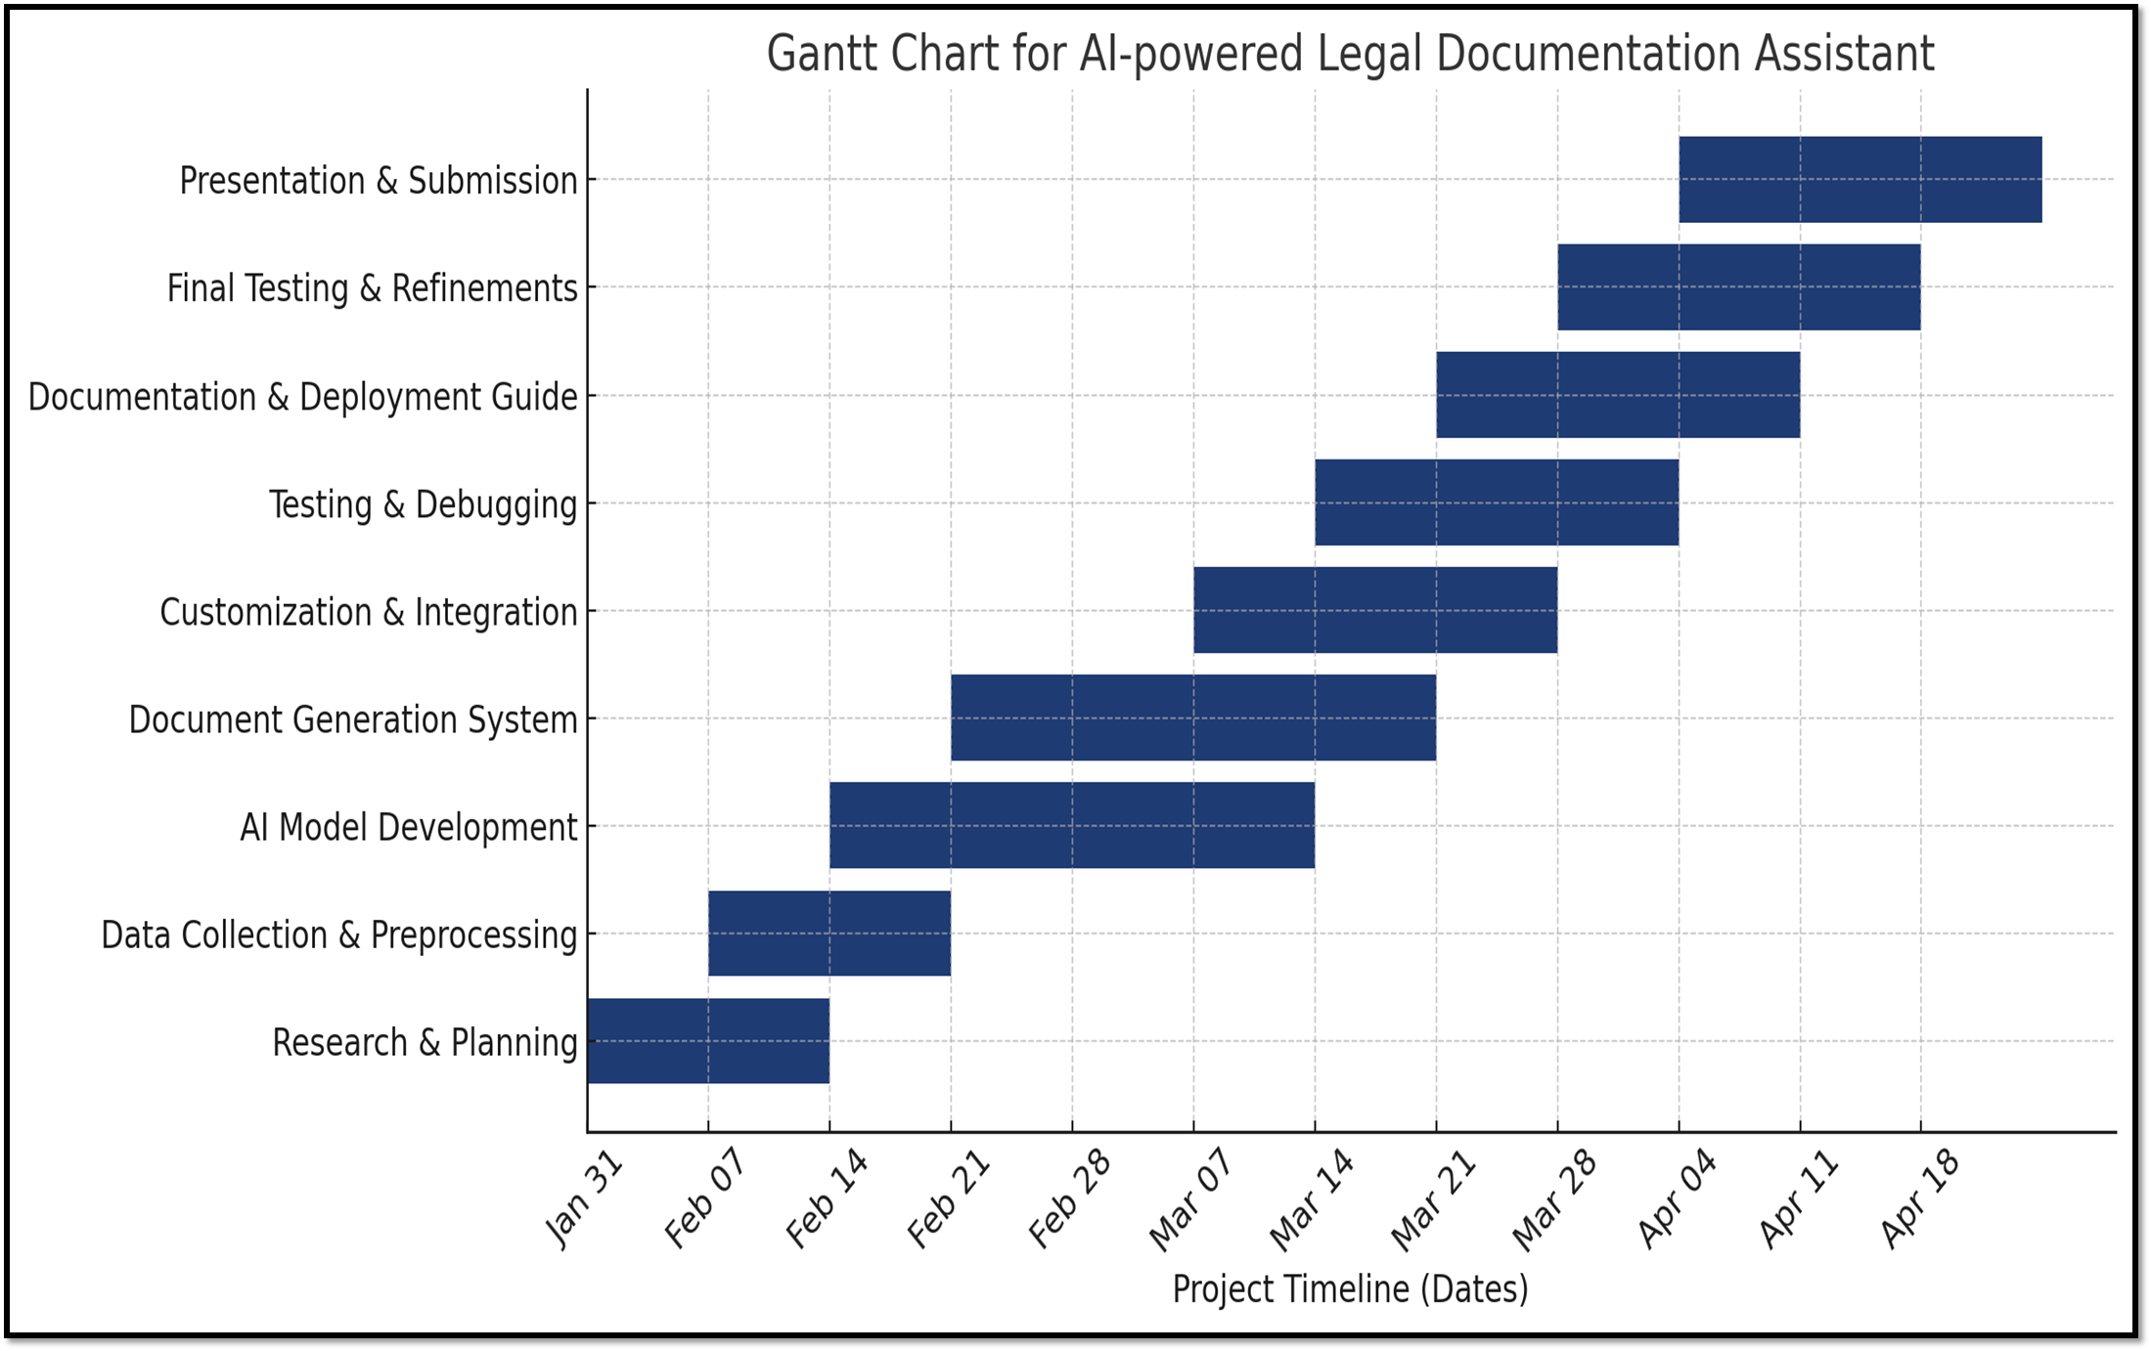
Timeline of the Project (Gantt Chart)

Slide 13
Outcomes/ Results Obtained
Automated Legal Document Generation – The system will generate legal documents in plain language based on user inputs, reducing the need for manual drafting.
Improved Accessibility to Legal Resources – Individuals and small businesses will be able to create legally sound documents without requiring extensive legal knowledge or professional assistance.
Reduction in Errors and Ambiguities – By utilizing AI and NLP techniques, the system will minimize common mistakes and misunderstandings in legal documents, ensuring clarity and accuracy.
Time and Cost Savings – Users will save significant time and legal expenses by automating the document drafting process rather than hiring a lawyer for basic legal paperwork.
Integration with Legal Databases – The AI model is expected to use publicly available legal resources to ensure that documents align with current legal standards and regulations.

Slide 14
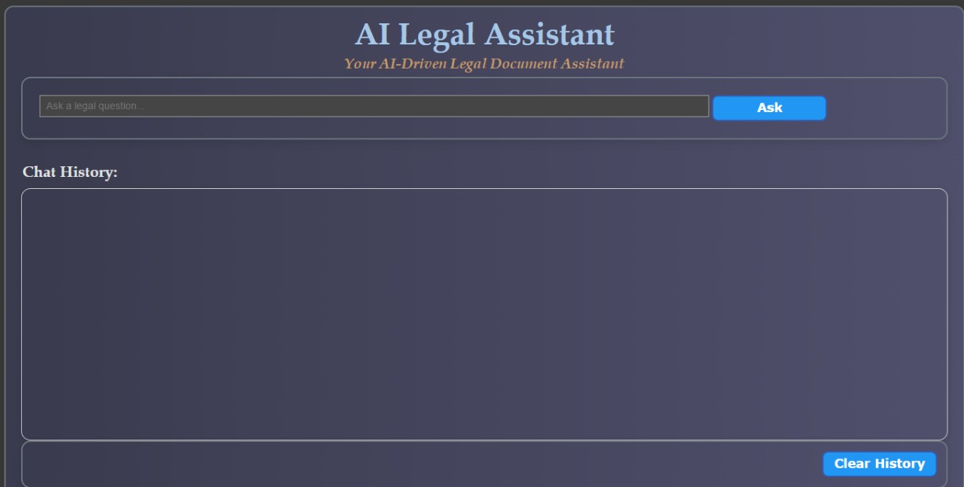
Outcomes/ Results Obtained
AI Chatbot Interface

Slide 15
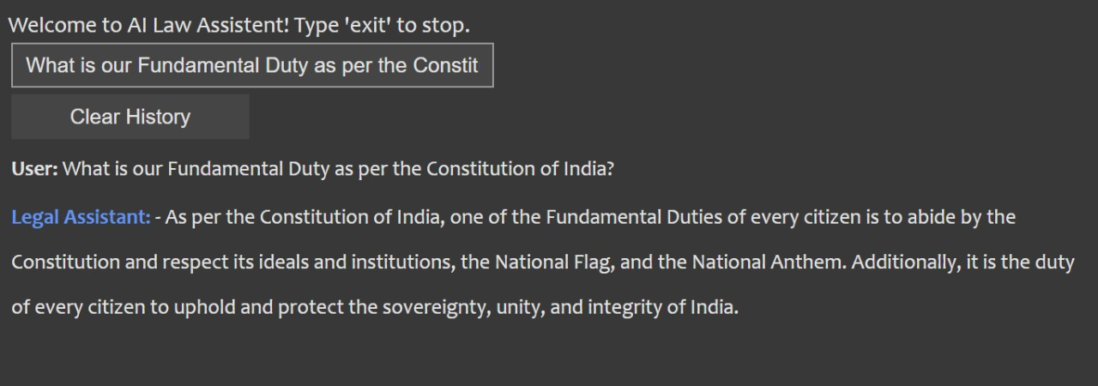
Outcomes/ Results Obtained
Chatbot responding to a legal query on fundamental rights

Slide 16
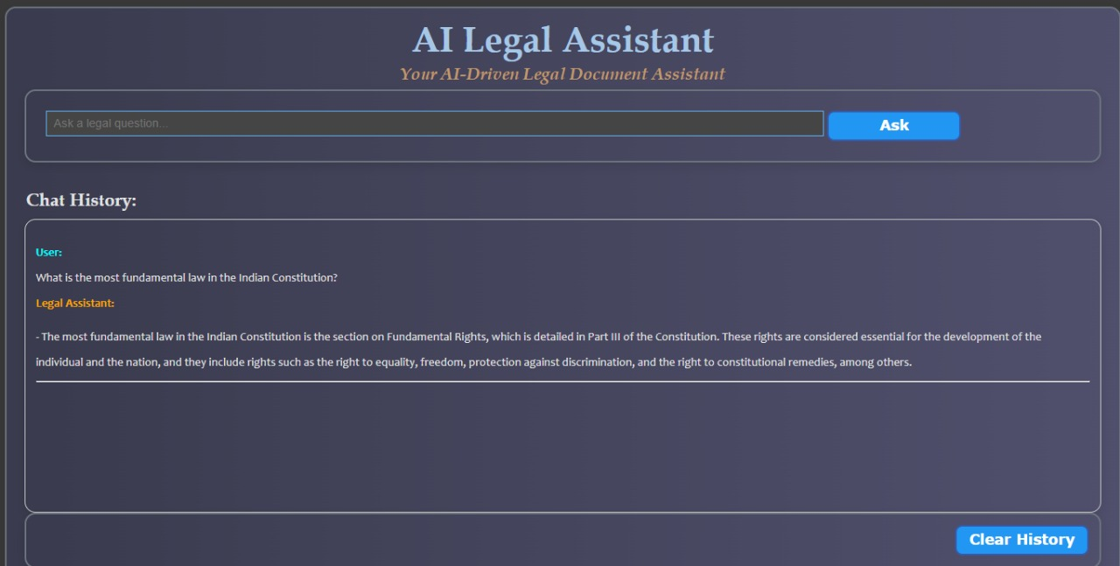
Outcomes/ Results Obtained
Response to a query on Fundamental Law by the Assistant

Slide 17
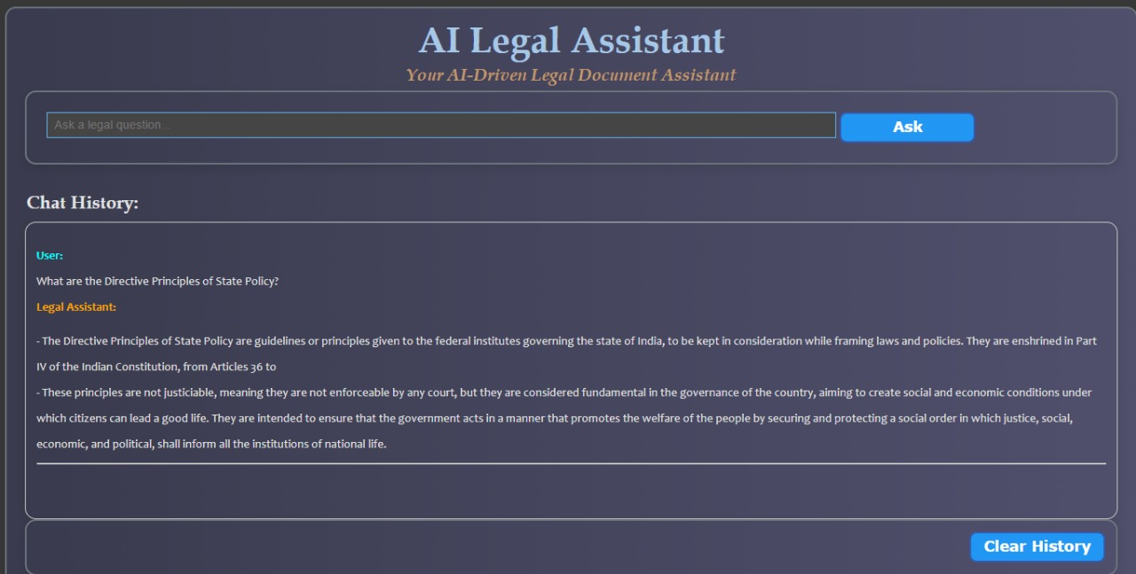
Outcomes/ Results Obtained
Response to a query on Directive Principles by the Assistant

Slide 18
Conclusion
The AI-powered Legal Documentation Assistant simplifies the legal drafting process for individuals and small businesses by generating accurate and easy-to-understand legal documents. By leveraging natural language processing (NLP) and machine learning techniques, our solution ensures that users can create legally sound documents without requiring extensive legal expertise.
Throughout the project, we developed a robust AI model capable of document generation, customization, and integration with legal resources. The system was designed with a focus on accuracy, efficiency, and usability, ensuring that users can generate documents with minimal errors while maintaining compliance with legal standards.
This project has the potential to significantly impact legal accessibility in India, where many individuals and small businesses struggle with complex legal paperwork due to a lack of resources. By reducing the time, effort, and costs associated with legal documentation, our solution promotes greater legal awareness and accessibility.

Slide 19
GitHub Link
The GitHub link provided should have public access permission.
https://github.com/vaishnavi-c-2025/AI-powered-Legal-Documentation-Assistant

Slide 20
References (IEEE Paper format)
[1]. Rithik Raj Pandey, Sarthak Khandelwal, Satyam Srivastava, Yash Triyar and Mrs. Muquitha Almas, “LegalSeva: AI - Powered Legal Documentation Assistant”, International Research Journal of Modernization in Engineering Technology and Science, vol. 06/Issue:03, March 2024.
[2]. Imogen Vimala, Sreenidhi J. and Nivedha V, “AI - Powered Legal Documentation Assistant”, Journal of Artificial Intelligence and Capsule Networks. 6. 210-226. 10.36548/jaicn.2024.2.007.
[3]. Awez Shaikh, Rizvi Mohd Farhan, Zahid Zakir Hussain and Shaikh Azlaan, "AI - Powered Legal Documentation Assistant", International Journal of Emerging Technologies and Innovative Research (www.jetir.org), ISSN:2349-5162, Vol.11, Issue 4, page no. k526-k530, April-2024.
[4]. G. Kiran Kumar, A. Shreyan, G. Harini, M. Balaram, (2024), “AI - Powered Legal Documentation Assistant”, International Journal of Engineering Innovations and Management Strategies 1 (1):1-13.

Slide 21
References (IEEE Paper format)
[5]. Lalita Panika, Aastha Gracy, Abhishek Khare, Sanket Mathur and S. Hariharan Reddy,
“SimpliLegal: An AI - Powered Legal Document Assistant”, International Research Journal of
Modernization in Engineering Technology and Science, vol. 06/Issue:04, April 2024.
[6]. M. E. Kauffman and M. N. Soares, "AI in legal services: New trends in AI-enabled legal
services," Service Oriented Computing and Applications, vol. 14, pp. 223–226, Oct. 2020, doi:
10.1007/s11761-020-00305-x.
[7]. S. Kapoor, P. Henderson, and A. Narayanan, "Promises and pitfalls of artificial intelligence
for legal applications," arXiv, Feb. 6, 2024.
[8]. L. B. Eliot, "AI and Legal Argumentation: Aligning the Autonomous Levels of AI Legal
Reasoning," arXiv preprint arXiv:2009.11180, 2020.
[9]. J. Cui, M. Ning, Z. Li, B. Chen, Y. Yan, H. Li, B. Ling, Y. Tian, and L. Yuan, "Chatlaw: A
Multi-Agent Collaborative Legal Assistant with Knowledge Graph Enhanced Mixture-of-Experts
Large Language Model," arXiv preprint arXiv:2306.16092, May 2024.

Slide 22
References (IEEE Paper format)
[10]. Q. Steenhuis, D. Colarusso, and B. Willey, "Weaving Pathways for Justice with GPT: LLM-
driven Automated Drafting of Interactive Legal Applications," arXiv preprint arXiv:2312.09198,
Dec. 2023.
[11]. D. Shah, J. Vasi, T. Gandhi, and K. Dabre, "AI & ML Based Legal Assistant," International
Research Journal of Engineering and Technology (IRJET), vol. 11, no. 07, pp. 706-708, Jul.
2024.
[12]. J. Aroraa, T. Patankara, A. Shaha, and S. Joshia, "Artificial Intelligence as Legal Research
Assistant," in Forum for Information Retrieval Evaluation (FIRE), Hyderabad, India, Dec. 2020.
[13]. P. N. Devaraj, R. T. P. V, M. K. R, and A. Gangrade, "Development of a Legal Document AI-
Chatbot," School of Computer Science and Engineering, Vellore Institute of Technology,
Chennai, India.
[14]. J. Lai, W. Gan, J. Wu, Z. Qi, and P. S. Yu, "Large Language Models in Law: A Survey,"
arXiv preprint, arXiv:2312.03718, Nov. 2023.
[15]. Nguyen, H. T., "A Brief Report on LawGPT 1.0: A Virtual Legal Assistant Based on GPT-3,"
arXiv preprint arXiv:2302.05729v2, 2023.

Slide 23

Project work mapping with SDG

Slide 24
Project work mapping with SDG
SDG 16: Peace, Justice and Strong Institutions
Our project strengthens justice and legal institutions by making legal knowledge more accessible and understandable to the public. It empowers citizens to exercise their rights, understand legal procedures, and access justice digitally, especially those with limited resources.
2. SDG 10: Reduced Inequalities
By offering free and easy-to-use legal assistance, our project helps bridge the gap between those who can afford legal services and those who cannot. It reduces inequalities in access to justice and legal literacy, supporting inclusion and social equity.
3. SDG 9: Industry, Innovation and Infrastructure
Our AI-powered legal assistant introduces innovation in the legal sector, promoting digital transformation. It builds intelligent infrastructure for legal services and fosters growth in AI-driven legal tech solutions.
4. SDG 4: Quality Education
The project contributes to legal education by helping users learn about constitutional rights, laws, and legal terms. It supports lifelong learning and awareness, especially in academic and community learning environments.

Slide 25

Thank You

